Slide 1

Can you identify
the hazards ?

Slide 2
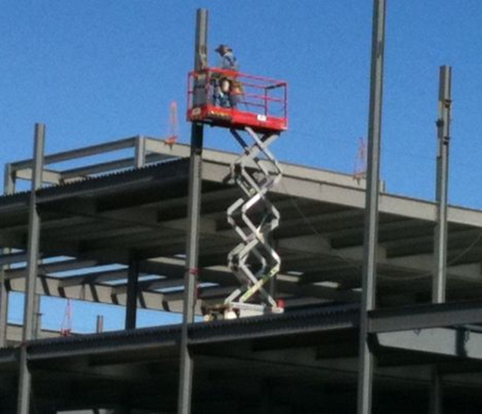
Potential Hazards:
Ejection
Tip-Over
Falling

Slide 3
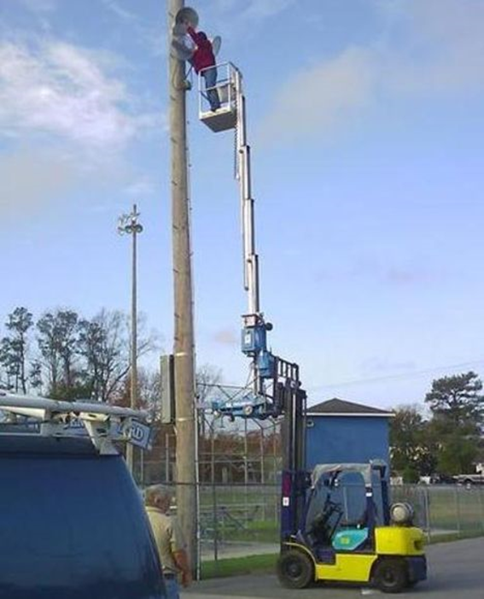
Potential Hazards:
Ejection
Tip-over
Falling

Slide 4
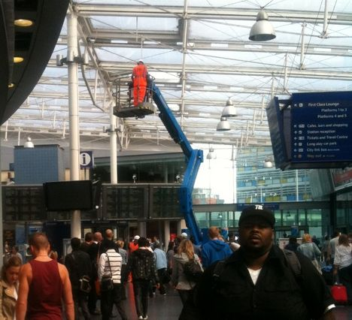
Potential Hazards:
Collision
Crushing
Falling

Slide 5
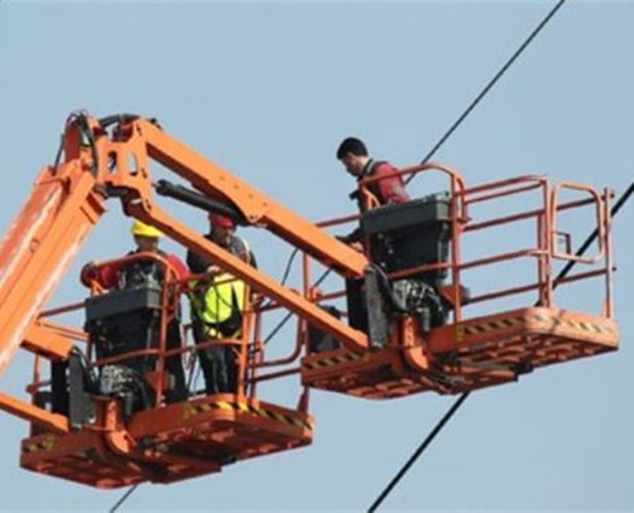
Potential Hazards:
Electrocution

Slide 6

Hazards of a
Improperly
Fitted Harness:
Falling out of your harness
Trauma to your throat or
Choking

Slide 7
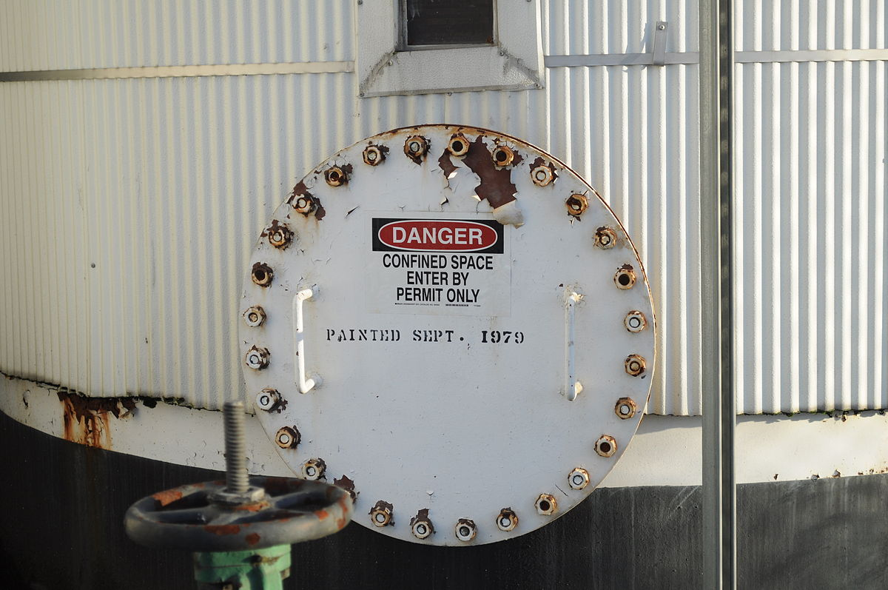
Confined Space
Hazards include :
Oxygen deficient
atmospheres
Toxic Atmospheres
Flammable or Explosive Atmospheres
Engulfment/
Entrapment

Slide 8
REGISTER TODAY and learn how to identify the hazards

